Slide 1


Animation
Animation
PowerPoint
Transitions
Morph
Dr Nitin Paranjape

Slide 2
Animation

Slide 3
Agenda
Animation
Transitions
Morph

Slide 4
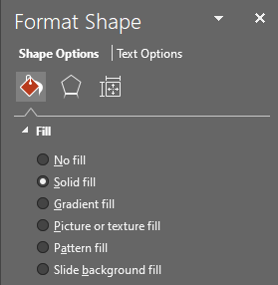
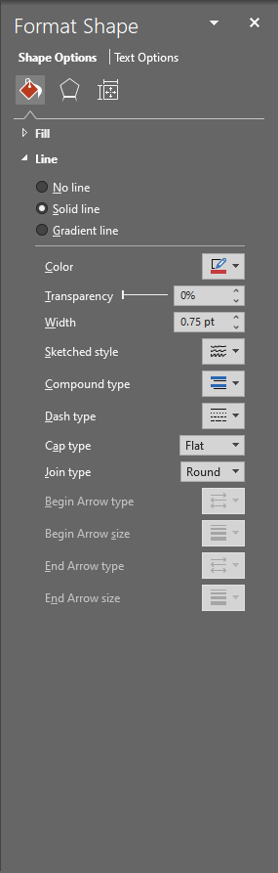
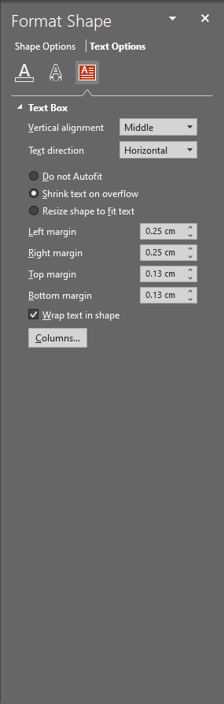
Step by Step

Slide 5

Entrance . Emphasis . Motion . Exit .

Slide 6
Transitions

Slide 7

Before - After

Slide 8

Transition: Crush

Slide 9

Launch / Introduce

Slide 10



Slide 11
abcdefghijklmnopqrstuvwxyz
ABCDEFGHIJKLMNOPQRSTUVWXYZ

Slide 12
Morph

Slide 15
ABCDEFGHIJKLMNOPQRSTUVWXYZ

Slide 16
THANK YOU

